Slide 1
ConnectBud
Python
Class 3
By: Rahul Joshi

Slide 2
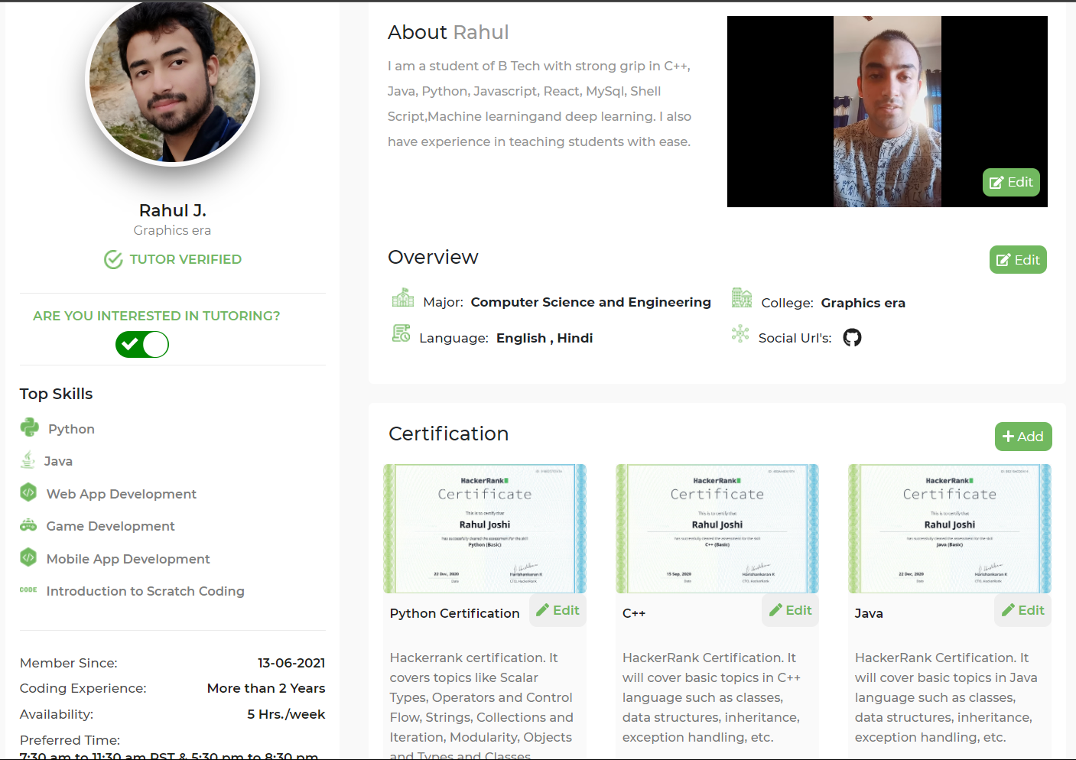

Slide 3
Class Overview
Class 3: • Data Types (Types of variables).

Slide 4
Types of Variables ( Data Type )
String : Sequence of characters
eg. C1=“arav”
2. Integer : Number
eg. C2 =11
3. Float : Fraction
eg. C3=45.74
4. Boolean : True/False
Command to check the data type:
Print(type(c1))

Slide 5
Few More
4. List : Collection of values
eg. Name=[“arav”, ”pant”]
ages=[11,21,32]
student1=[“arav”,11,”pant”]
student2=[“Rahul”,21,”joshi”]
Arav
11
pant
rahul
21
joshi
student1
student2

Slide 6
Index
Arav
11
pant
0
1
2

Slide 7
Program
c1="arav"
c2=11
c3=45.74
print(type(c1))
print(type(c2))
print(type(c3))
l1=["arav",11,"pant"]
print(l1)
print(l1[0])
print(l1[1])
print(l1[2])
c4=True
c5=False
print(type(c4))
print(c4)
print(c5)
c6="True"
print(c6)
print(type(c6))

Slide 8
Task
Create the list of your friends data i.e name, age,marks, hobbies.
Also print sum of the ages of friends.
lst=["name",21,[98,97,94,[56,47,34]],56]
print(lst[2][3][1])
#print out using the negative index only.

Slide 9
End
For any queries: Contact:
Rahul Joshi rj26280218@gmail.com

